Slide 1
Template Method Design Pattern
12 December 2024
Shriwatsal Patil

Slide 2
What is a Template Method ?
Template Method is a behavioral design pattern that defines the skeleton of an algorithm in the superclass but lets subclasses override specific steps of the algorithm without changing its structure.
Purpose:
Define the structure of an algorithm with Customizable steps.
To promote code reusability and maintain consistency across variations of an algorithm
How it Works:
It defines the overall structure of an algorithm in a base class, where the steps of the algorithm are implemented as a series of methods.
Some steps in the algorithm are implemented in the parent class, while others are left as abstract methods, allowing subclasses to define specific behavior for those steps.
Subclasses implement only the variable parts of the algorithm, ensuring that the core logic is reused and executed in a consistent manner.

Slide 3
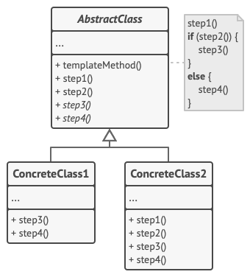
Structure of the Template Pattern
Template Method Pattern: Defines the structure of an algorithm in a base class.
Fixed Order of Operations: The order of operations in the algorithm is predefined in the base class.
Abstract Class: Declares methods that represent the steps of the algorithm.
Template Method: Calls these steps in a specific order, ensuring a consistent flow.
Step Implementations:
Some steps are abstract and must be implemented by subclasses.
Some steps have default implementations which can be overridden if necessary.
Subclasses:
Cannot modify the template method itself.
Can override individual steps to customize behavior.

Slide 4
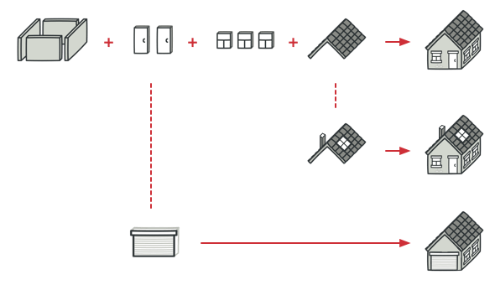
Real-World Analogy: Mass Housing Construction
The architectural plan for building a standard house may contain several extension points that would let a potential owner adjust some details of the resulting house.
Each building step, such as laying the foundation, framing, building walls, installing plumbing and wiring for water and electricity, etc., can be slightly changed to make the resulting house a little bit different from others.

Slide 5
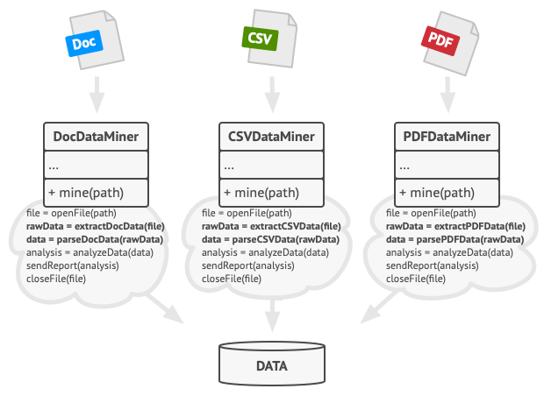
Problem:
Create a data mining application that analyzes corporate documents.
Users feed the app documents in various formats (PDF, DOC, CSV), and it tries to extract meaningful data from these docs in a uniform format.
Template Method Solution:
Algorithm→Series of Steps→Methods
The client only needs to call convert(filename, format) without dealing with the complexities of the framework.
Benefits:
Code Reusability: Enabling the reuse of common steps across different document formats while customizing the specific extraction logic.
Simplified Client Interaction : Client needs to call only one method , No need to know all the backend for each and every function.
Data Mining Application

Slide 6
Pros and Cons of Facade Pattern
Pros:
→ You can let clients override only certain parts of a large algorithm, making them less affected by changes that happen to other parts of the algorithm.
→ You can pull the duplicate code into a superclass.
Cons:
→Some clients may be limited by the provided skeleton of an algorithm.
→ You might violate the Liskov Substitution Principle by suppressing a default step implementation via a subclass.
→ Template methods tend to be harder to maintain the more steps they have.
.

Slide 7
When to Use the Template Method Design Pattern
When the algorithm's structure is fixed: Define the overall flow, while allowing flexibility in specific steps.
When steps of an algorithm are common across classes: Reuse code in an abstract class while allowing custom behavior in subclasses.
When you need to control the flow of the algorithm: Ensure a consistent order of operations, while allowing customization.
When multiple classes share similar behavior: Avoid duplication by centralizing common logic in an abstract class.
When you want to enforce a standard process: Ensure that subclasses follow the same general process while varying specific steps.

Slide 8




THANK YOU
(844) 720-6678
info@simplifyhealthcare.com
simplifyhealthcare.com
Simplify Healthcare
U.S.: 600 N Commons Drive, Suite 110, Aurora, IL 60504
India: 401/402, 4th Floor, Pentagon P-2, Magarpatta City, Pune 411013
CONNECT WITH US
LinkedIn
YouTube
X
Instagram

